Slide 1
4NPS Fast Food Application Mockups

Slide 2
4 Nutrient Profiling System
4x protein minimum
b
‘Nutrient to limit’ content
Sodium
Saturated Fat
<1x Limit
<1x Limit
3x protein minimum
1x – 2x limit
1x – 2x limit
>2x Limit
>2x Limit
F + P* < 1
1 < F + P < 2
Turkey Sandwich
420 kcal
2 < F + P < 4
2x protein minimum
F + P > 4
Target
*Fiber (F) and protein (P)
relative to minimum
requirement
Meal
580 kcal
1a
1b
1x protein minimum
1c
Black Bean Soup
170 kcal
½ Healthy Range
Target minimum (1x fiber, 1x protein)
Protein
Limit
Potato Chips
160 kcal
Soft Drink
160 kcal
Fiber
1x fiber minimum
2x fiber minimum
3x fiber minimum
4x fiber minimum

Slide 4
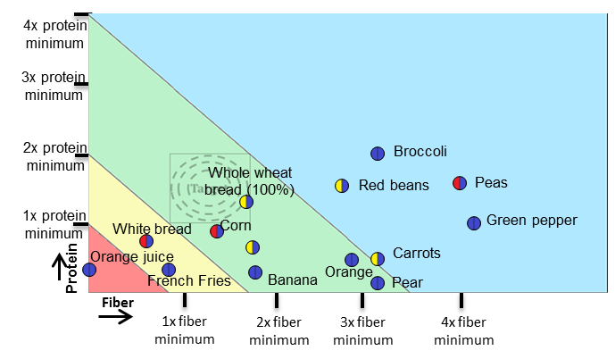
Ratings of common fiber sources
Whole fruit > fruit juice
Whole wheat > refined

Slide 5
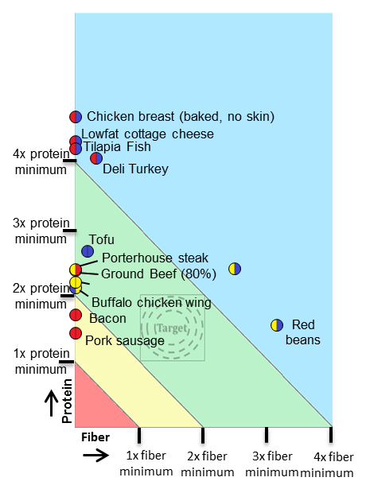
Protein sources visually
differentiate
Lean proteins and beans
encouraged

Slide 6
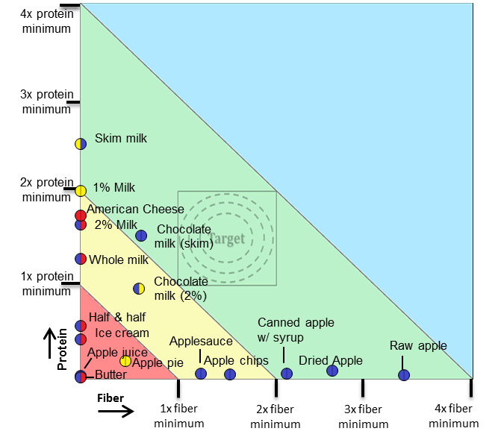
Ratings change with processing

Slide 7
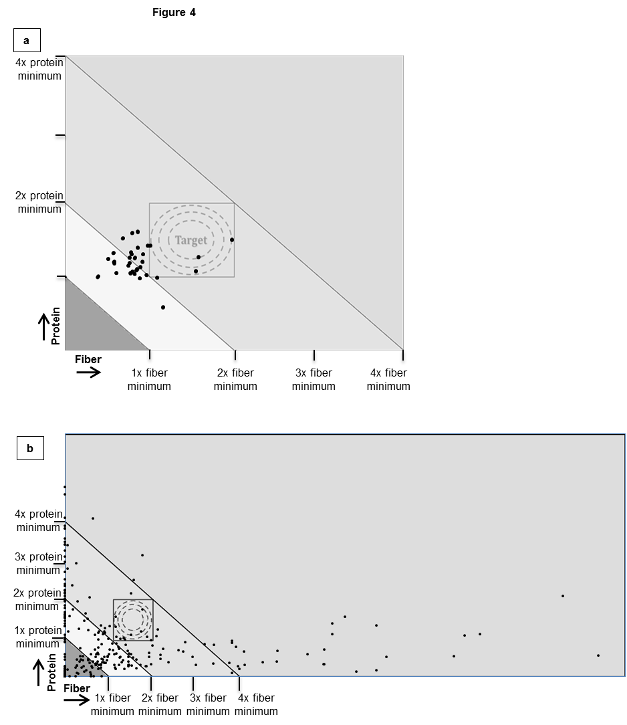
Champaign High School lunch
menu for May, 2010
300 most frequently
eaten foods in USA

Slide 8

All figures should have this basic outline, data points will vary
‘Nutrient to limit’ content
Sodium
Saturated Fat
<1x Limit
<1x Limit
1x – 2x limit
1x – 2x limit
>2x Limit
>2x Limit
F + P* < 1
1 < F + P < 2
2 < F + P < 4
F + P > 4
*Fiber (F) and protein (P)
relative to minimum
requirement
Axes should be “1x, 2x”, etc, color coded plot and data points,
show fiber and protein directions, label food items and show kcal per serving
when possible, draw arrow and show label if something is off the chart (or allow
user to scan rest of chart with touchscreen), legend included somewhere in the app
(maybe a “what does this mean” menu button at bottom menu list)

Slide 9
Main screen: “what do you want to see?”
List of Restaurants (future – GPS showing closest restaurants)
Option to show summaries? (depends on how well menu is broken down – hard to compare restaurants)
Hungry for a specific food and want to compare between restaurants? (problematic when restaurants organize differently – chicken/beef or “sandwiches”)
If possible, show summaries of similar restaurant menu subsections (ie sandwich, salad), then can click on each restaurant’s summary and it will expand to that restaurants specific menu for that subsection
Search

Slide 10
Four Nutrient Profiling System
1. Choose restaurant from list or what’s near me (GPS)
2. Hungry for something specific?
3. Search for food item, restaurant, or keyword
4. Saved meals/favorites?
5. Help/walkthrough/instructions/FAQ
Options: Basic/advanced mode – will change axes to be more detailed

Slide 11





1. List of Restaurants “Where are you/want to go?:
Either alphabetical order
or popularity/location-based
Total menu summaries of restaurants
4x protein minimum
b
McDonald’s
3x protein minimum
Panera
2x protein minimum
Target
Burger King
1x protein minimum
Burger King
Panera
Subway
Pizza Hut
Pizza Hut
McDonald’s
Protein
Subway
Click
Fiber
1x fiber minimum
2x fiber minimum
3x fiber minimum
4x fiber minimum
See Summary Comparisons
Summaries will do formula for all foods at restaurant
to give overall rating (exclude beverages or include 1 size
of all and 1 “soda” summary for all sodas – difficult with
different serving sizes of foods on menu
Clicking a restaurant will bring up a summary
of that menu’s subsections (like slide 6 and 7)

Slide 12
Once a restaurant is selected, 2 options come up
“Make a meal” – fast, very simple meal formation for a user who wants to choose a good meal quickly
Entrée is selected from menu
(all entrée choices plotted, they choose which they want OR
List of menu subsections will come up if menu is too large to show all entrees at once (ie choose from burger, chicken, etc, then plot will show all items in that subsection)
Several side items are then suggested that will be the best for the meal
Explore – look through the restaurant’s offerings
Compare menu subsections, foods within each subsections, play with foods to form different meals, etc.

Slide 13
“Make a Meal” option (Arby’s chosen)
Entrees shown on plot
Labels appear when zooming
Selection of food will take to
side item suggestion screen

Slide 14
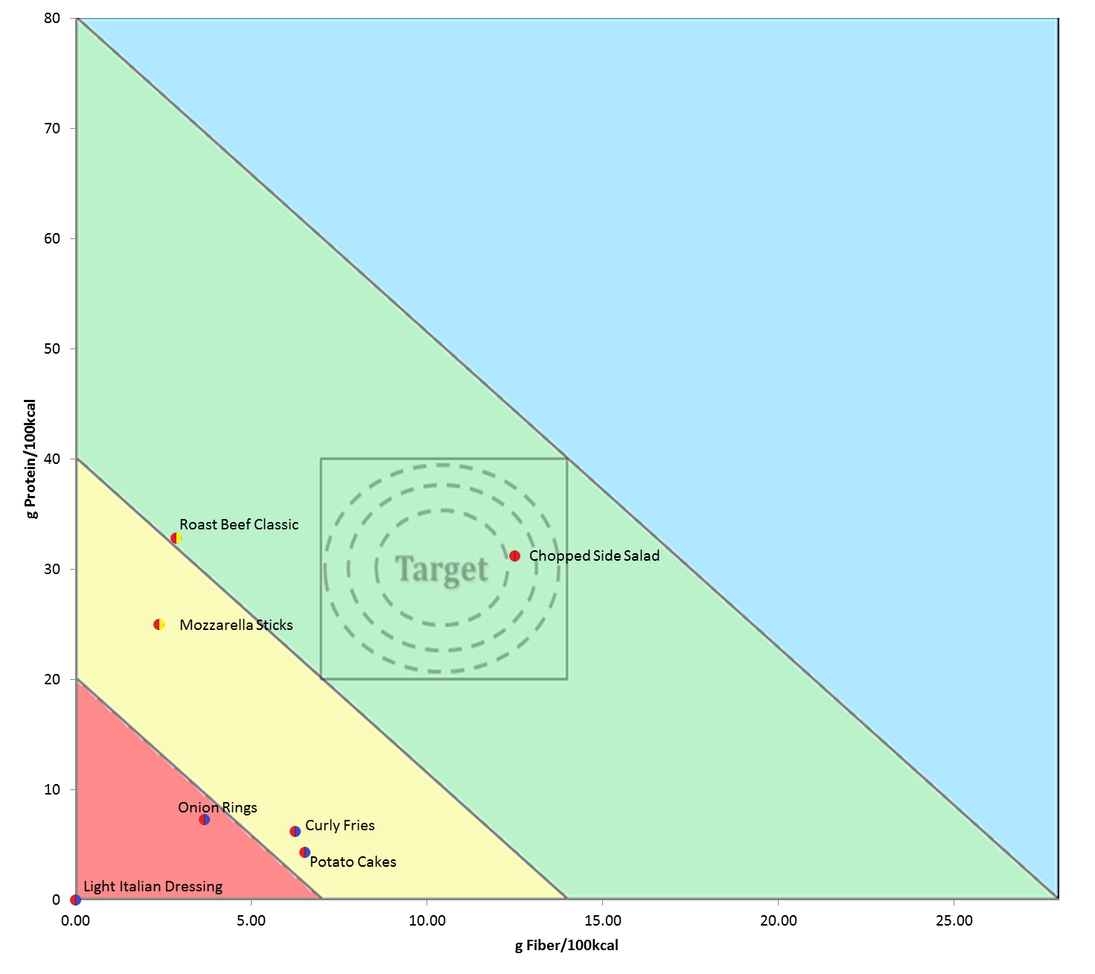
“Make a Meal” option (Arby’s chosen)
Highlight one that would bring
combination closest to target
Show others to discourage bad
selections

Slide 15
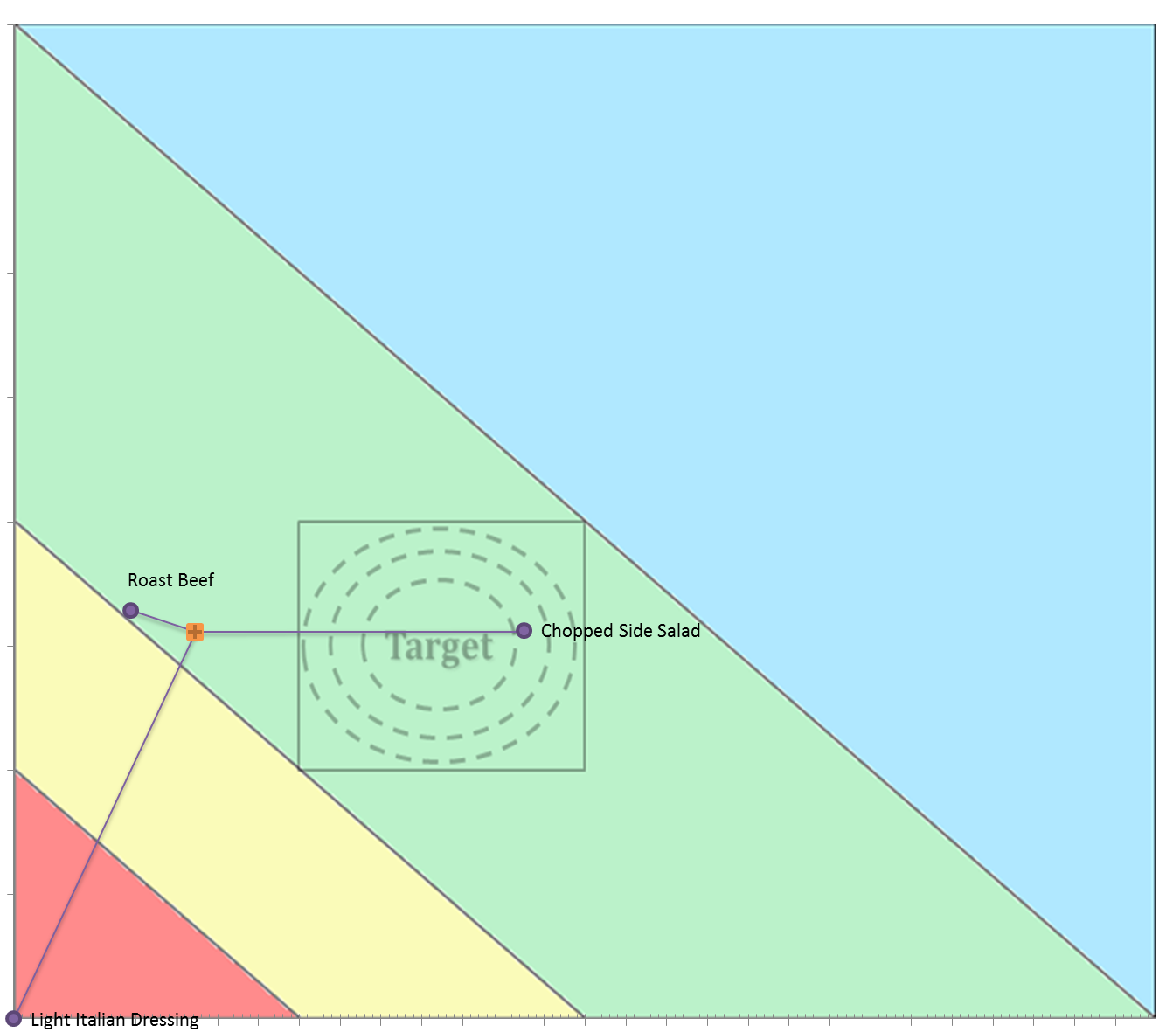
“Make a Meal” option (Arby’s chosen)
Meal formation step shown

Slide 16
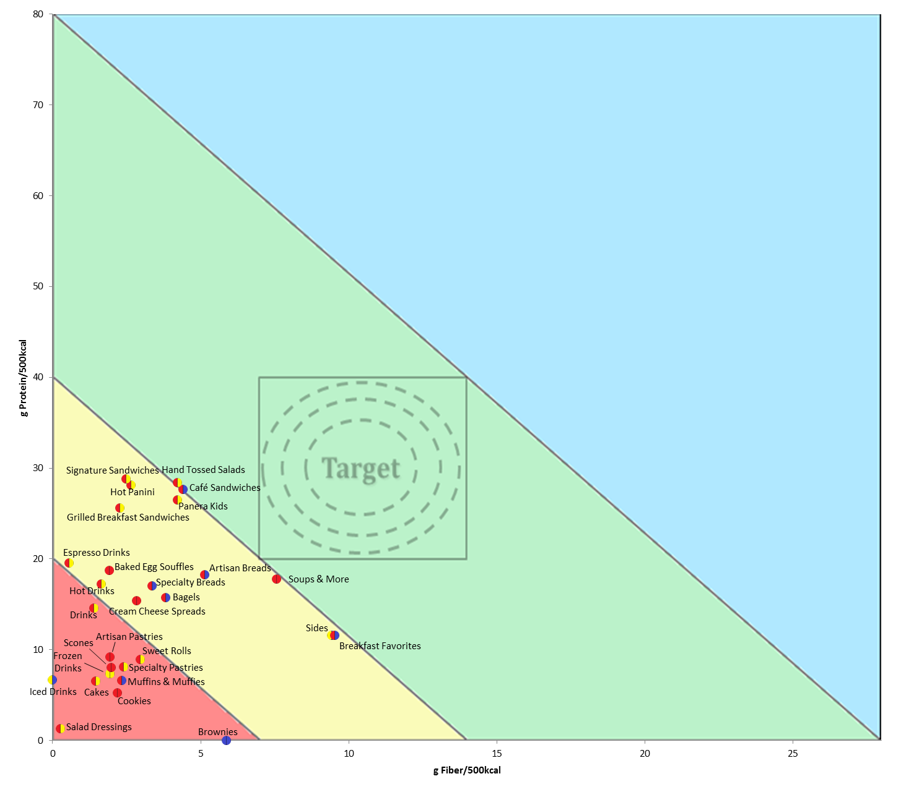
Clicking a restaurant from the list will bring up a summary of each of its subsections
Panera
Have app screen zoom on whatever area contains the most data points? Determine a way to intuitively show the necessary information on a small screen. Data labels may be difficult to include or position automatically? Show as mouse/thumbover if needed
Notes:
Have app screen zoom on whatever area contains the most data points? Determine a way to intuitively show the necessary information on a small screen. Data labels may be difficult to include or position automatically? Show as mouse/thumbover if needed

Slide 17
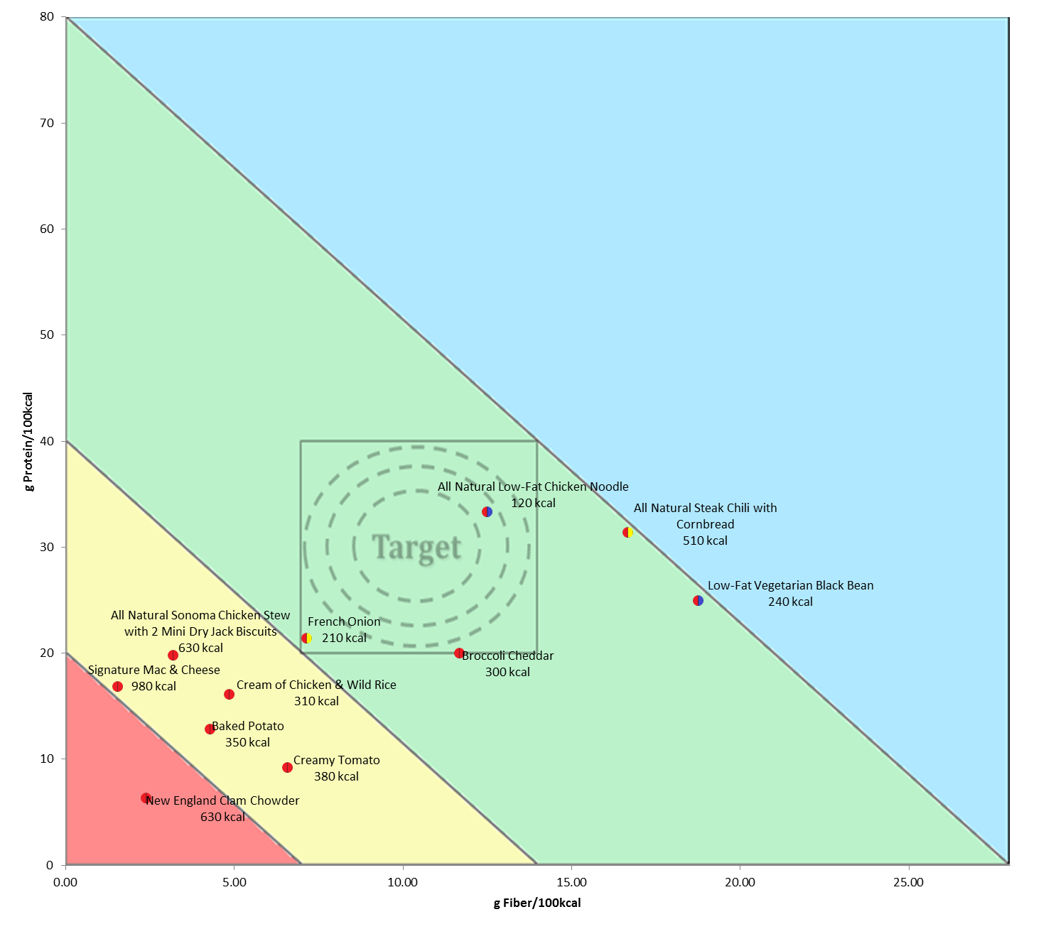
Clicking a subsection of a specific restaurant (ie soups from panera) will bring up a screen summarizing each item from that subsection
Different sizes will show different kcal – what solution? “you pick two” vs bowl vs cup of soup. Have mini list pop up and ask what size they’d like to add/see? Default show kcal of a specific size?
Large orders of soup shown
Notes:
Need to have select and compare for different menu sections – list menu as a whole or do subsections if needed. Example – Person wants to compare broccoli cheese soup to a sandwich – Have them click on soup and a mini list of options come up including “compare”, “add to meal”, “add to day” if tracking their diet longer than a meal-by-meal basis
Different sizes will show different kcal – what solution? “you pick two” vs bowl vs cup of soup. Have mini list pop up and ask what size they’d like to add/see? Default show kcal of a specific size?

Slide 18
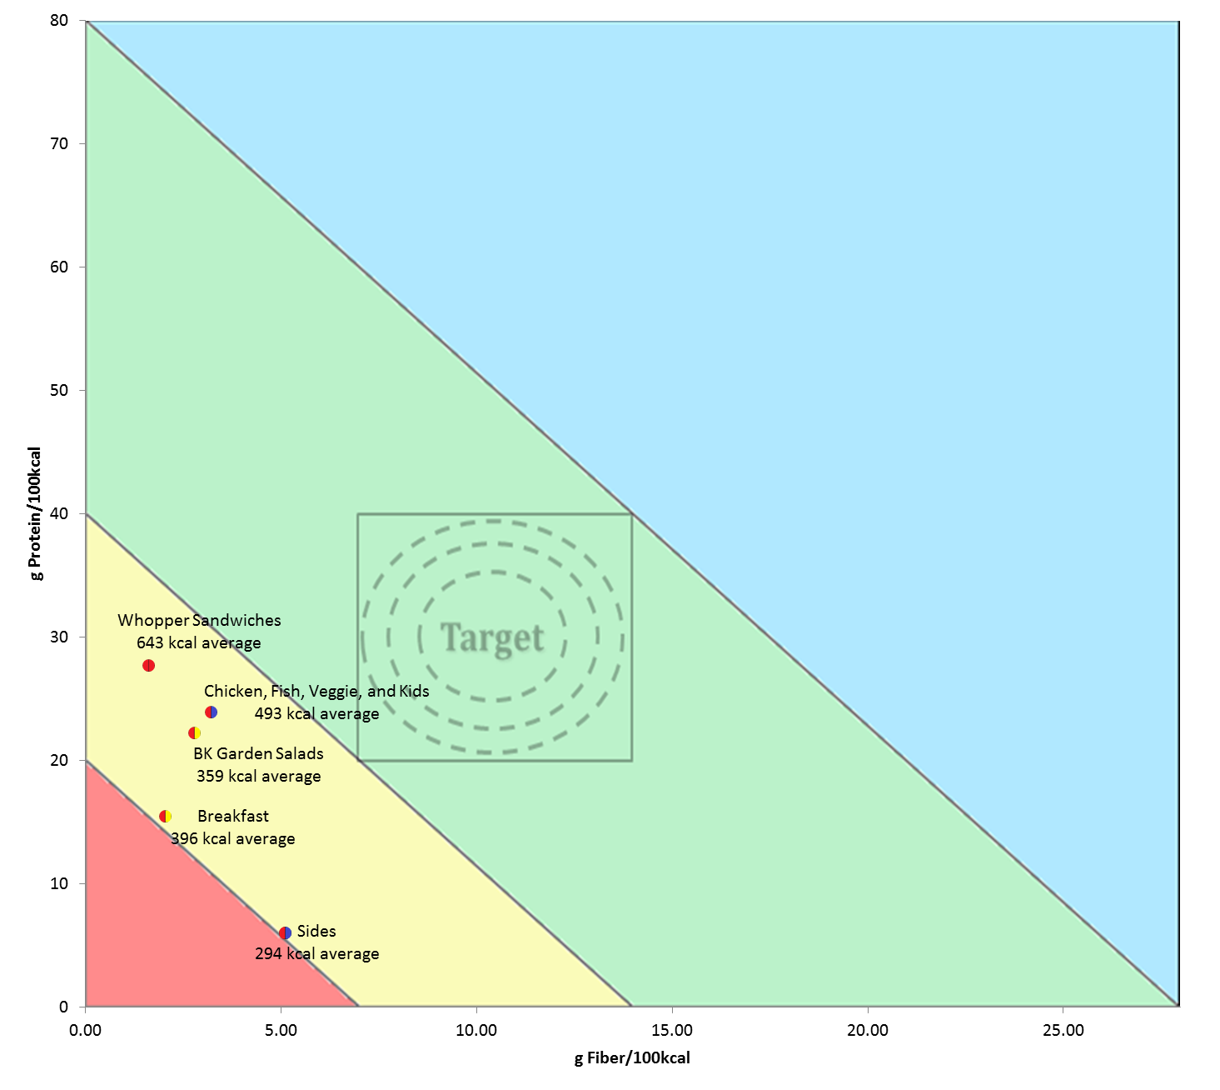
Clicking a restaurant from the list will bring up a summary of each of its subsections
Burger King
Show average kcal per item in each subsection,
if space allows, or show on click/mouseover
Notes:
Try to make labels easier to read

Slide 19
2. Specific food categories: “what are you hungry for?”
Entrees
Sandwich comparison between restaurants
4x protein minimum
b
Sandwiches
Click
3x protein minimum
Soups
Salads
2x protein minimum
Target
Desserts/treats
Arby’s
Panera
1x protein minimum
Burger King
Subway
McDonald’s
Tacos (or other varieties)
Protein
Fiber
1x fiber minimum
2x fiber minimum
3x fiber minimum
4x fiber minimum
Sandwiches difficult for different restaurants – panera has several subsections, could be chicken/beef organized (like BK), etc.
Build a meal or alacarte like microsize project decent approach. “Microsized” is recommending similar foods closest to the target.
Only comparing “sandwich” portion of
each restaurant’s menu
Clicking a restaurant will bring up that
Restaurant’s sub-menu (like slide 10)
Notes:
Sandwiches difficult for different restaurants – panera has several subsections, could be chicken/beef organized (like BK), etc.
Build a meal or alacarte like microsize project decent approach. “Microsized” is recommending similar foods closest to the target.

Slide 20
Clicking a subsection of a specific restaurant (ie soups from panera) will bring up a screen summarizing each item from that subsection
Large orders of soup shown
Notes:
Need to have select and compare for different menu sections – list menu as a whole or do subsections if needed. Example – Person wants to compare broccoli cheese soup to a sandwich – Have them click on soup and a mini list of options come up including “compare”, “add to meal”, “add to day” if tracking their diet longer than a meal-by-meal basis
Different sizes will show different kcal – what solution? “you pick two” vs bowl vs cup of soup. Have mini list pop up and ask what size they’d like to add/see? Default show kcal of a specific size?

Slide 21
When a food is clicked, a navigation menu will pop up:
Compare with:
Back to submenu selection or food listing of whole restaurant, or search
Any foods added to this (cumulative list they can edit so they can play with it) are shown on a new plot
Recommendations once selected? Similar foods that are closer to target
Add to meal
Same as comparison – foods are tracked and added together on a new plot when this is selected, then a combined meal dot is shown, as well, to track combination of foods
Suggestions can then be made depending on where meal is relative to summary square and what menu subsections they ordered from
Summary will show kcal
Able to store meals (as individual foods combining into summary circle) to review what they ate previously, which combinations at which restaurants were good, etc.
Some kind of folder in main menu as “favorites” if they want to save meals, or a history organized by restaurant, or whatever would be most intuitive
Item clicked, this menu pops up
Compare to another food
See summary of comparisons
Add to meal
See meal
See history/tracked foods/previous meals

Slide 22
3. Search
Input restaurant name, food item, or keyword

Slide 23
Main Screen Menu
Manual entry
Search
Demo/Instructions
Saved/history/favorites
Choose restaurant from list
Make a Meal
Explore
Everything after line is on FP plot
Entrée selection from plot
Menu subsection summaries on plot
Tapping subsection will bring up plot
With suggested side items
Tapping subsection will bring up plot
with all foods within that section
Suggestions for 1) healthier entrée and 2) healthiest side item choice if wanted
Comparison of foods within subsection
Meal Summary (each food and summary circle)
Static menu on bottom of screen with:
Home (main screen or restaurant)
view comparisons (FP plot with “saved” foods/add foods
if already on that screen
“what does it mean” – summary of figure legends

Slide 24
Minimum Software requirements
Demonstration/instruction screen showing walkthrough of how to use system
Access database, plot foods, and intuitively show all necessary information (food name, fib, protein, saturated fat, sodium, calories, etc)
Combine foods to make a meal on FP plot
Suggestions for healthier entrée once chosen in make a meal, then suggestions for healthiest side item if selected
Manual data entry and storage, storage of favorite meals or previous meals that fit the target range
Some menu like: to pop up when foods are clicked while exploring.
More directed for “make a meal”: maybe “add a side?, suggest better entrée?”, etc.
Compare to another food
See summary of comparisons
Add to meal
See meal
See history/tracked foods/previous meals

